Slide 1
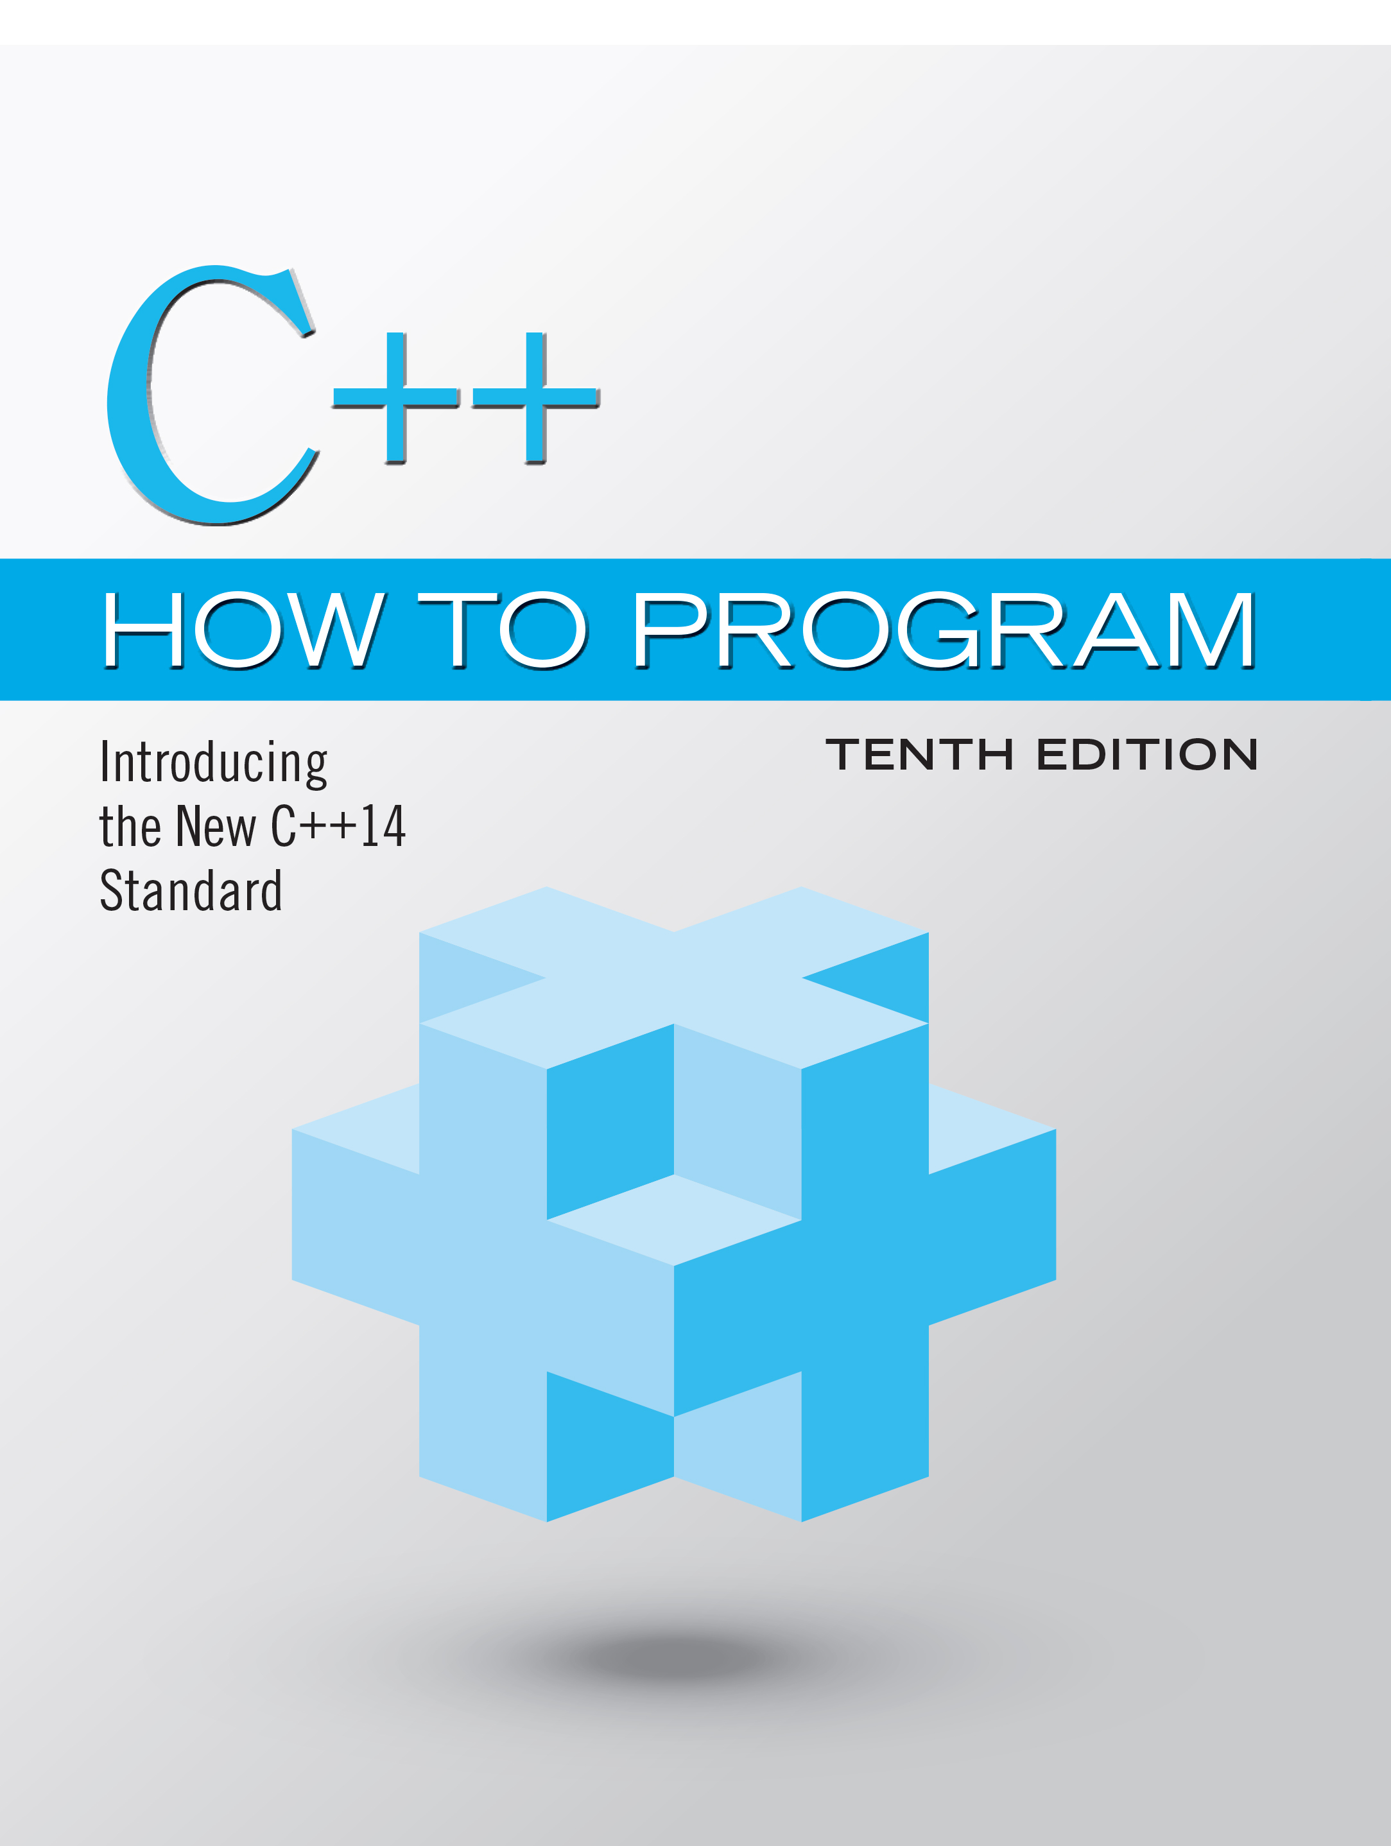
C++ How to Program: Introducing the New C++14 Standard
Tenth Edition
Chapter 8
Pointers
Copyright © 2017, 2014, 2012 Pearson Education, Inc. All Rights Reserved
Notes:
If this PowerPoint presentation contains mathematical equations, you may need to check that your computer has the following installed:
1) MathType Plugin
2) Math Player (free versions available)
3) NVDA Reader (free versions available)

Slide 2
Learning Objectives (1 of 2)
Learn what pointers are.
Declare and initialize pointers.
Use the address (&) and indirection (*) pointer operators.
Learn the similarities and differences between pointers and references.
Use pointers to pass arguments to functions by reference.
Use built-in arrays.

Slide 3
Learning Objectives (2 of 2)
Use const with pointers.
Use operator sizeof to determine the number of bytes that store a value of a particular type.
Understand pointer expressions and pointer arithmetic.
Understand the close relationships between pointers and built-in arrays.
Use pointer-based strings.
Use C++11 capabilities, including nullptr and Standard Library functions begin and end.

Slide 4
Outline (1 of 5)
8.1 Introduction
8.2 Pointer Variable Declarations and Initialization
8.2.1 Declaring Pointers
8.2.2 Initializing Pointers
8.2.3 Null Pointers Prior to C++11
8.3 Pointer Operators
8.3.1 Address (&) Operator
8.3.2 Indirection (*) Operator
8.3.3 Using the Address (&) and Indirection (*) Operators

Slide 5
Outline (2 of 5)
8.4 Pass-by-Reference with Pointers
8.5 Built-In Arrays
8.5.1 Declaring and Accessing a Built-In Array
8.5.2 Initializing Built-In Arrays
8.5.3 Passing Built-In Arrays to Functions
8.5.4 Declaring Built-In Array Parameters
8.5.5 C++11: Standard Library Functions begin and end
8.5.6 Built-In Array Limitations
8.5.7 Built-In Arrays Sometimes Are Required

Slide 6
Outline (3 of 5)
8.6 Using const with Pointers
8.6.1 Nonconstant Pointer to Nonconstant Data
8.6.2 Nonconstant Pointer to Constant Data
8.6.3 Constant Pointer to Nonconstant Data
8.6.4 Constant Pointer to Constant Data
8.7 sizeof Operator

Slide 7
Outline (4 of 5)
8.8 Pointer Expressions and Pointer Arithmetic
8.8.1 Adding Integers to and Subtracting Integers from Pointers
8.8.2 Subtracting Pointers
8.8.3 Pointer Assignment
8.8.4 Cannot Dereference a void*
8.8.5 Comparing Pointers

Slide 8
Outline (5 of 5)
8.9 Relationship Between Pointers and Built-In Arrays
8.9.1 Pointer/Offset Notation
8.9.2 Pointer/Offset Notation with the Built-In Array’s Name as the Pointer
8.9.3 Pointer/Subscript Notation
8.9.4 Demonstrating the Relationship Between Pointers and Built-In Arrays
8.10 Pointer-Based Strings (Optional)
8.11 Note About Smart Pointers
8.12 Wrap-Up

Slide 9
8.1 Introduction
Pointers are one of the most powerful, yet challenging to use, C++ capabilities.
We’ll discuss when it’s appropriate to use pointers, and show how to use them correctly and responsibly.
Pointers also enable pass-by-reference and can be used to create and manipulate pointer-based dynamic data structures.
We also show the intimate relationship among built-in arrays and pointers.
In new software development projects, you should favor array and vector objects to built-in arrays.

Slide 10
Software Engineering Observation 8.1
In new software development projects, you should favor array and vector objects to builtin arrays, and string objects to C strings.

Slide 11
8.2 Pointer Variable Declarations and Initialization
A pointer contains the memory address of a variable that, in turn, contains a specific value.
In this sense, a variable name directly references a value, and a pointer indirectly references a value.
Referencing a value through a pointer is called indirection.
Diagrams typically represent a pointer as an arrow from the variable that contains an address to the variable located at that address in memory.

Slide 12
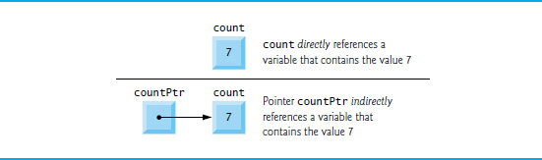
Figure 8.1 Directly and Indirectly Referencing a Variable

Slide 13
8.2.1 Delcaring Pointers
The declaration
int* countPtr, count;
declares the variable count Ptr to be of type int* (i.e., a pointer to an int value) and is read (right to left), “countPtr is a pointer to int.”
Variable count in the preceding declaration is declared to be an int, not a pointer to an int.
The * in the declaration applies only to countPtr.
Each variable being declared as a pointer must be preceded by an asterisk (*).
When * appears in a declaration, it is not an operator—it indicates that the variable being declared is a pointer.
Pointers can be declared to point to objects of any type.

Slide 14
Common Programming Error 8.1
Assuming that the * used to declare a pointer distributes to all names in a declaration’s comma-separated list of variables can lead to errors. Each pointer must be declared with the * prefixed to the name (with or without spaces in between). Declaring only one variable per declaration helps avoid these types of errors and improves program readability.

Slide 15
Good Programming Practice 8.1
Although it’s not a requirement, we like to include the letters Ptr in each pointer variable name to make it clear that the variable is a pointer and must be handled accordingly.

Slide 16
8.2.2 Initializing Pointers
Pointers should be initialized to nullptr (new in C++11) or to a memory either when they’re declared or in an assignment.
A pointer with the value nullptr “points to nothing” and is known as a null pointer.
From this point forward, when we refer to a “null pointer” we mean a pointer with the value nullptr.

Slide 17
Error-Prevention Tip 8.1
Initialize all pointers to prevent pointing to unknown or uninitialized areas of memory.

Slide 18
8.2.3 Null Pointers Prior to C++11
In earlier versions of C++, the value specified for a null pointer was 0 or NULL.
NULL is defined in several standard library headers to represent the value 0.
Initializing a pointer to NULL is equivalent to initializing a pointer to 0, but prior to C++11, 0 was used by convention.
The value 0 is the only integer value that can be assigned directly to a pointer variable without first casting the integer to a pointer type.

Slide 19
8.3 Pointer Operators
The unary operators & and * are used to create pointer values and “dereference” pointers, respectively.

Slide 20
8.3.1 Address (&) Operator (1 of 2)
The address operator (&) is a unary operator that obtains the memory address of its operand.
Assuming the declarations
the statement
assigns the address of the variable y to pointer variable yPtr
Figure 8.2 shows a representation of memory after the preceding assignment.

Slide 21

Figure 8.2 Graphical Representation of a Pointer Pointing to a Variable in Memory

Slide 22
8.3.1 Address (&) Operator (2 of 2)
Figure 8.3 shows another pointer representation in memory with integer variable y stored at memory location 600000 and pointer variable yPtr stored at location 500000.
The operand of the address operator must be an lvalue—the address operator cannot be applied to constants or to expressions that result in temporary values (like the results of calculations).

Slide 23

Figure 8.3 Representation of y and yPtr in Memory

Slide 24
8.3.2 Indirection (*) Operator
The unary * operator—commonly referred to as the indirection operator or dereferencing operator—returns an lvalue representing the object to which its pointer operand points.
Called dereferencing a pointer
A dereferenced pointer may also be used as an lvalue on the left side of an assignment.

Slide 25
Common Programming Error 8.2
Dereferencing an uninitialized pointer results in undefined behavior that could cause a fatal execution-time error. This could also lead to accidentally modifying important data, allowing the program to run to completion, possibly with incorrect results.

Slide 26
Error-Prevention Tip 8.2
Dereferencing a null pointer results in undefined behavior and typically causes a fatal execution-time error. Ensure that a pointer is not null before dereferencing it.

Slide 27
8.3.3 Using the Address (&) and Indirection (*) Operators (1 of 2)
The program in Figure 8.4 demonstrates the & and * pointer operators.

Slide 28
Portability Tip 8.1
The memory addresses output by this program with c out and << are platform dependent, so you may get different results when you run the program.

Slide 29
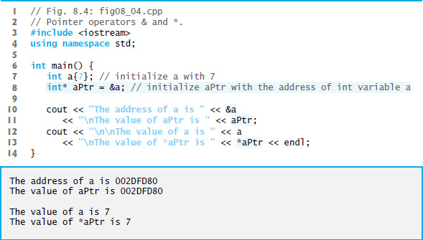
Figure 8.4 Pointer Operators & and *

Slide 30
8.3.3 Using the Address (&) and Indirection (*) Operators (2 of 2)
Precedence and Associativity of the Operators Discussed So Far
Figure 8.5 lists the precedence and associativity of the operators introduced to this point.
The address (&) and dereferencing operator (*) are unary operators on the fourth level.

Slide 31
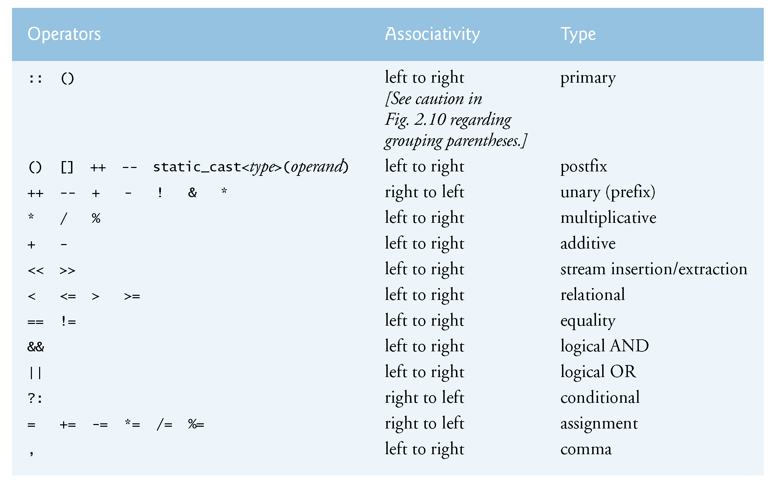
Figure 8.5 Operator Precedence and Associativity of the Operators Discussed So Far

Slide 32
8.4 Pass-By-Reference with Pointers (1 of 6)
There are three ways in C++ to pass arguments to a function
pass-by-value
pass-by-reference with reference arguments
pass-by-reference with pointer arguments.
Here, we explain pass-by-reference with pointer arguments.

Slide 33
8.4 Pass-By-Reference with Pointers (2 of 6)
Pointers can be used to modify one or more variables in the caller or to pass pointers to large data objects to avoid the overhead of copying the objects.
You can use pointers and the indirection operator (*) to accomplish pass-by-reference.
When calling a function with an argument that should be modified, the address of the argument is passed.

Slide 34
8.4 Pass-By-Reference with Pointers (3 of 6)
An Example of Pass-By-Value
Figure 8.6 passes variable number by value to function cube By Value, which cubes its argument and passes the new value result back to main using a return statement.
The calling function has the opportunity to examine the function call’s result before modifying any variable’s values.

Slide 35
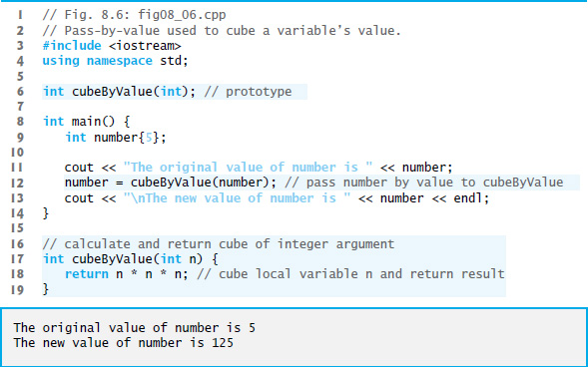
Figure 8.6 Pass-By-Value Used to Cube a Variable’s Value

Slide 36
8.4 Pass-By-Reference with Pointers (4 of 6)
An Example of Pass-By-Reference with Pointers
Figure 8.7 passes the variable number to function cube By Reference using pass-by-reference with a pointer argument—the address of number is passed to the function.
The function uses the dereferenced pointer to cube the value to which nPtr points.
This directly changes the value of number in main.

Slide 37
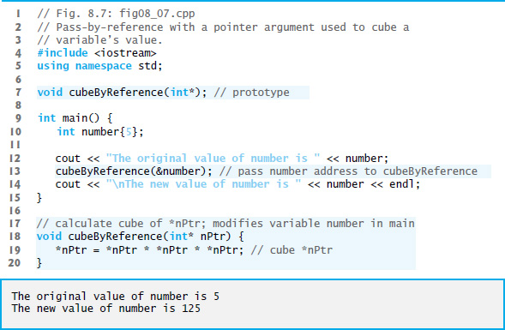
Figure 8.7 Pass-By-Reference with a Pointer Argument Used to Cube a Variable’s Value

Slide 38
8.4 Pass-By-Reference with Pointers (5 of 6)
Insight: All Arguments Are Passed By Value
Passing a variable by reference with a pointer does not actually pass anything by reference—a pointer to that variable is passed by value and is copied into the function’s corresponding pointer parameter.
The called function can then access that variable in the caller simply by dereferencing the pointer, thus accomplishing pass-by-reference.

Slide 39
8.4 Pass-By-Reference with Pointers (6 of 6)
Graphical Analysis of Pass-By-Value and Pass-By-Reference
Figures 8.8–8.9 analyze graphically the execution of the programs in Figure 8.6 and Figure 8.7, respectively.
In the diagrams, the values in blue rectangles above a given expression or variable represent the value of that expression or variable.
Each diagram’s right column shows functions cube By Value (Figure 8.6) and cube By Reference (Figure 8.7) only when they’re executing.

Slide 40
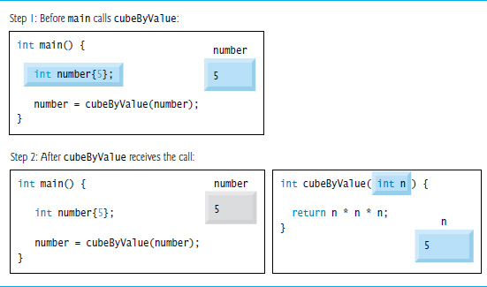
Figure 8.8 Pass-By-Value Analysis of the Program of Figure 8.6 (1 of 3)

Slide 41
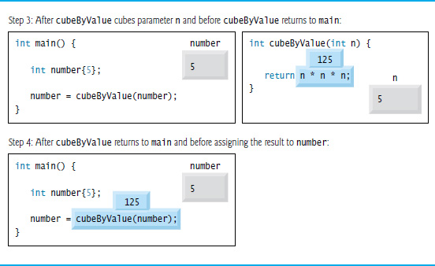
Figure 8.8 Pass-By-Value Analysis of the Program of Figure 8.6 (2 of 3)

Slide 42
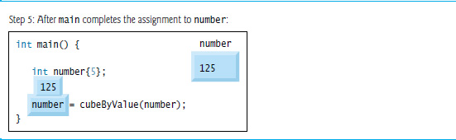
Figure 8.8 Pass-By-Value Analysis of the Program of Figure 8.6 (3 of 3)

Slide 43
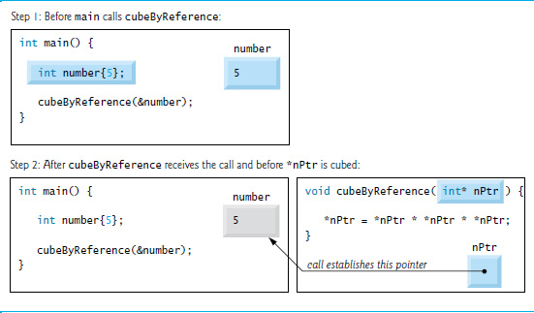
Figure 8.9 Pass-By-Reference Analysis of the Program of Figure 8.7 (1 of 3)

Slide 44
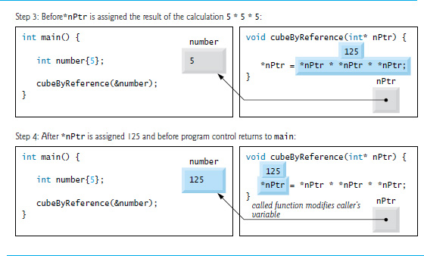
Figure 8.9 Pass-By-Reference Analysis of the Program of Figure 8.7 (2 of 3)

Slide 45
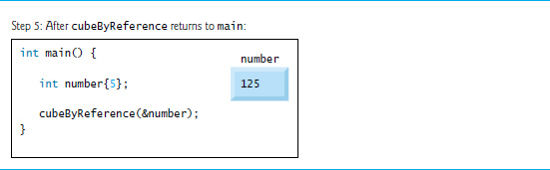
Figure 8.9 Pass-By-Reference Analysis of the Program of Figure 8.7 (3 of 3)

Slide 46
8.5 Built-In Arrays
Here we present built-in arrays, which are also fixed-size data structures.

Slide 47

8.5.1 Declaring and Accessing a Built-In Array
To specify the type of the elements and the number of elements required by a built-in array, use a declaration of the form:
type array Name[array Size];
The compiler reserves the appropriate amount of memory.
array Size must be an integer constant greater than zero.
To reserve 12 elements for built-in array of ints named c, use the declaration
As with array objects, you use the subscript ([]) operator to access the individual elements of a built-in array.

Slide 48
8.5.2 Initializing Built-In Arrays (1 of 2)
You can initialize the elements of a built-in array using an initializer list as in
creates a built-in array of five ints and initializes them to the values in the initializer list.
If you provide fewer initializers
the number of elements, the remaining elements are value initialized—fundamental numeric types are set to 0, bools are set to false, pointers are set to nullptr and class objects are initialized by their default constructors.
If you provide too many initializers a compilation error occurs.

Slide 49
8.5.2 Initializing Built-In Arrays (2 of 2)
If a built-in array’s size is omitted from a declaration with an initializer list, the compiler sizes the built-in array to the number of elements in the initializer list.
For example,
creates a five-element array.

Slide 50
Error-Prevention Tip 8.3
Always specify a built-in array’s size, even when providing an initializer list. This enables the compiler to generate an error message if there are more initializers than array elements.

Slide 51
8.5.3 Passing Built-In Arrays to Functions
The value of a built-in array’s name is implicitly convertible to the address of the built-in array’s first element.
So array Name is implicitly convertible to &array Name[0].
You don’t need to take the address (&) of a built-in array to pass it to a function—you simply pass the built-in array’s name.
For built-in arrays, the called function can modify all the elements of a built-in array in the caller—unless the function precedes the corresponding built-in array parameter with const to indicate that the elements should not be modified.

Slide 52
Software Engineering Observation 8.2
Applying the const type qualifier to a built-in array parameter in a function definition to prevent the original built-in array from being modified in the function body is another example of the principle of least privilege. Functions should not be given the capability to modify a built-in array unless it’s absolutely necessary.

Slide 53
8.5.4 Declaring Built-In Array Parameters (1 of 2)
You can declare a built-in array parameter in a function header, as follows:
which indicates that the function’s first argument should be a one-dimensional built-in array of ints that should not be modified by the function.
The preceding header can also be written as:

Slide 54
8.5.4 Declaring Built-In Array Parameters (2 of 2)
The compiler does not differentiate between a function that receives a pointer and a function that receives a built-in array.
The function must “know” when it’s receiving a built-in array or simply a single variable that’s being passed by reference.
When the compiler encounters a function parameter for a one-dimensional built-in array of the form const int values[], the compiler converts the parameter to the pointer notation const int* values.
These forms of declaring a one-dimensional built-in array parameter are interchangeable.

Slide 55
Good Programming Practice 8.2
When declaring a built-in array parameter, for clarity use the [] notation rather than pointer notation.

Slide 56

8.5.5 C++11: Standard Library Functions Begin and End (1 of 2)
In Section 7.7, we showed how to sort an array object with the C++ Standard Library function sort.
We sorted an array of strings called colors as follows:
The array class’s begin and end functions specified that the entire array should be sorted.

Slide 57

8.5.5 C++11: Standard Library Functions Begin and End (2 of 2)
Function sort (and many other C++ Standard Library functions) can also be applied to built-in arrays.
For example, to sort the built-in array n shown earlier in this section, you can write:
C++11’s new begin and end functions (from header <iterator>) each receive a built-in array as an argument and return a pointer that can be used to represent ranges of elements to process in C++ Standard Library functions like sort.

Slide 58
8.5.6 Built-In Array Limitations
Built-in arrays have several limitations:
They cannot be compared using the relational and equality operators—you must use a loop to compare two built-in arrays element by element.
They cannot be assigned to one another.
They don’t know their own size—a function that processes a built-in array typically receives both the built-in array’s name and its size as arguments.
They don’t provide automatic bounds checking—you must ensure that array-access expressions use subscripts that are within the built-in array’s bounds.

Slide 59
8.5.7 Built-In Arrays Sometimes Are Required (1 of 2)
There are cases in which built-in arrays must be used, such as processing a program’s command-line arguments.
You supply command-line arguments to a program by placing them after the program’s name when executing it from the command line. Such arguments typically pass options to a program.

Slide 60
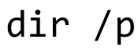
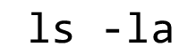
8.5.7 Built-In Arrays Sometimes Are Required (2 of 2)
On a Windows computer, the command
uses the /p argument to list the contents of the current directory, pausing after each screen of information.
On Linux or O S X, the following command uses the -la argument to list the contents of the current directory with details about each file and directory:

Slide 61
8.6 Using Const with Pointers (1 of 2)
Many possibilities exist for using (or not using) const with function parameters.
Principle of least privilege
Always give a function enough access to the data in its parameters to accomplish its specified task, but no more.

Slide 62
Software Engineering Observation 8.3
If a value does not (or should not) change in the body of a function to which it’s passed, the parameter should be declared const.

Slide 63
Error-Prevention Tip 8.4
Before using a function, check its function prototype to determine the parameters that it can and cannot modify.

Slide 64
8.6 Using Const with Pointers (2 of 2)
There are four ways to pass a pointer to a function
a nonconstant pointer to nonconstant data
a nonconstant pointer to constant data (Figure 8.10)
a constant pointer to nonconstant data (Figure 8.11)
a constant pointer to constant data (Figure 8.12)
Each combination provides a different level of access privilege.

Slide 65
8.6.1 Nonconstant Pointer to Nonconstant Data
The highest access is granted by a nonconstant pointer to nonconstant data
The data can be modified through the dereferenced pointer
The pointer can be modified to point to other data.
Such a pointer’s declaration (e.g., int* countPtr) does not include const.

Slide 66
8.6.2 Nonconstant Pointer to Constant Data
Nonconstant pointer to constant data
A pointer that can be modified to point to any item of the appropriate type
The data to which it points cannot be modified through that pointer
Sample declaration:
Read from right to left as “countPtr is a pointer to an integer constant” or more precisely, “countPtr is a non-constant pointer to an integer constant.”
Figure 8.10 demonstrates G N U C++’s compilation error message produced when attempting to compile a function that receives a nonconstant pointer to constant data, then tries to use that pointer to modify the data.

Slide 67
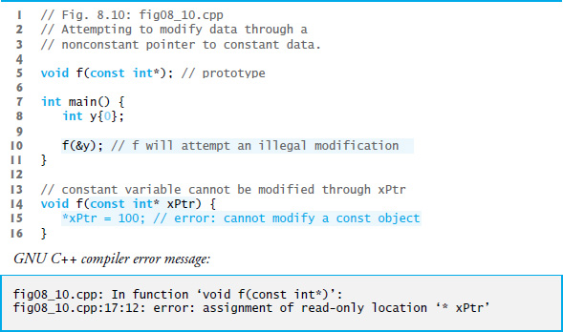
Figure 8.10 Attempting to Modify Data Through a Nonconstant Pointer to Const Data

Slide 68
Performance Tip 8.1
If they do not need to be modified by the called function, pass large objects using pointers to constant data or references to constant data, to obtain the performance benefits of passby-reference and avoid the copy overhead of pass-by-value.

Slide 69
Software Engineering Observation 8.4
Passing large objects using pointers to constant data, or references to constant data offers the security of pass-by-value.

Slide 70
Software Engineering Observation 8.5
Use pass-by-value to pass fundamental-type arguments (e.g., ints, doubles, etc.) to a function unless the caller explicitly requires that the called function be able to directly modify the value in the caller. This is another example of the principle of least privilege.

Slide 71
8.6.3 Constant Pointer to Nonconstant Data
Constant pointer to nonconstant data
always points to the same memory location
the data at that location can be modified through the pointer
Pointers that are declared const must be initialized when they’re declared.
If the pointer is a function parameter, it’s initialized with a pointer that’s passed to the function.
Figure 8.11 attempts to modify a constant pointer.

Slide 72
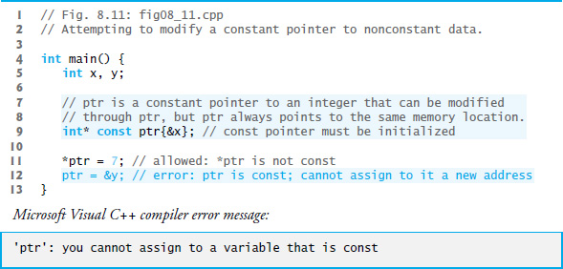
Figure 8.11 Attempting to Modify a Constant Pointer to Nonconstant Data

Slide 73
8.6.4 Constant Pointer to Constant Data (1 of 2)
The minimum access privilege is granted by a constant pointer to constant data.
Such a pointer always points to the same memory location
The data at that location cannot be modified via the pointer.
This is how a built-in array should be passed to a function that only reads from the built-in array, using array subscript notation, and does not modify the built-in array.

Slide 74
8.6.4 Constant Pointer to Constant Data (2 of 2)
const int* const
Read from right to left as “ptr is a constant pointer to an integer constant.”
Figure 8.12 shows the Xcode L L V M compiler’s error messages that are generated when an attempt is made to modify the data to which ptr points and when an attempt is made to modify the address stored in the pointer variable—these show up on the lines of code with the errors in the Xcode text editor.

Slide 75
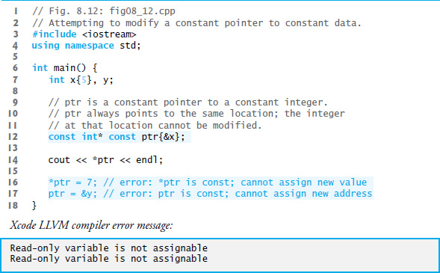
Figure 8.12 Attempting to Modify a Constant Pointer to Constant Data

Slide 76
8.7 Sizeof Operator (1 of 4)
The unary operator size of determines the size in bytes of a built-in array or of any other data type, variable or constant during program compilation.
When applied to a built-in array’s name, as in Figure 8.13, the size of operator returns the total number of bytes in the built-in array as a value of type size_t.
When applied to a pointer parameter in a function that receives a built-in array as an argument, the size of operator returns the size of the pointer in bytes—not the built-in array’s size.

Slide 77
Common Programming Error 8.3
Using the size of operator in a function to find the size in bytes of a built-in array parameter results in the size in bytes of a pointer, not the size in bytes of the built-in array.

Slide 78
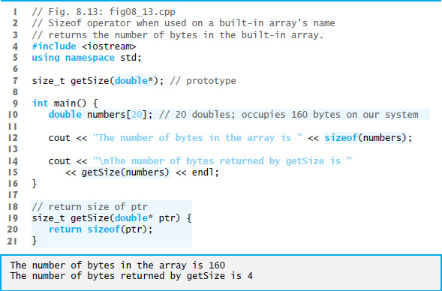
Figure 8.13 Size of Operator When Applied to a Built-In Array’s Name Returns the Number of Bytes in the Built-In Array (1 of 2)

Slide 79
Figure 8.13 Size of Operator When Applied to a Built-In Array’s Name Returns the Number of Bytes in the Built-In Array (2 of 2)

Slide 80
8.7 Sizeof Operator (2 of 4)
To determine the number of elements in the built-in array numbers, use the following expression (which is evaluated at compile time) :
The expression divides the number of bytes in numbers by the number of bytes in the built-in array’s zeroth element.

Slide 81
8.7 Sizeof Operator (3 of 4)
Figure 8.14 uses size of to calculate the number of bytes used to store many of the standard data types.
The output was produced using the default settings in X code 7.2 on Mac O S X.
Type sizes are platform dependent.

Slide 82
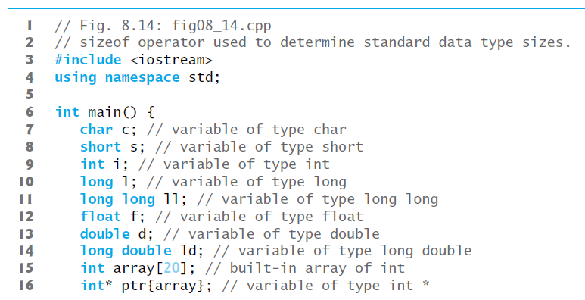
Figure 8.14 Sizeof Operator Used to Determine Standard Data Type Sizes (1 of 3)

Slide 83
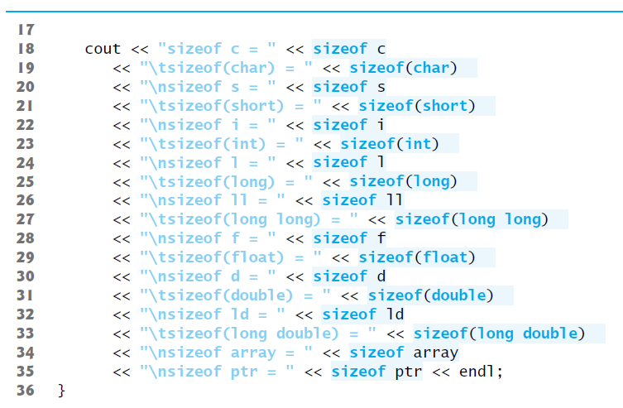
Figure 8.14 Sizeof Operator Used to Determine Standard Data Type Sizes (2 of 3)

Slide 84
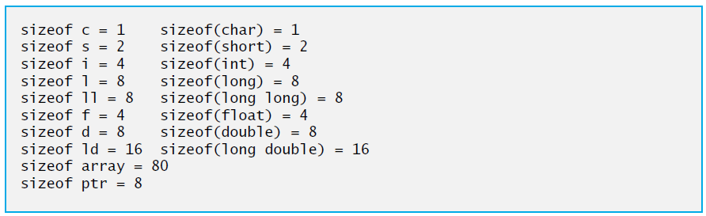
Figure 8.14 Sizeof Operator Used to Determine Standard Data Type Sizes (3 of 3)

Slide 85
Portability Tip 8.2
The number of bytes used to store a particular data type may vary among systems. When writing programs that depend on data type sizes, always use size of to determine the number of bytes used to store the data types.

Slide 86
8.7 Sizeof Operator (4 of 4)
Operator sizeof can be applied to any expression or type name.
When size of is applied to a variable name (which is not a built-in array’s name) or other expression, the number of bytes used to store the specific type of the expression is returned.
The parentheses used with size of are required only if a type name is supplied as its operand.

Slide 87
8.8 Pointer Expressions and Pointer Arithmetic (1 of 2)
Pointers are valid operands in arithmetic expressions, assignment expressions and comparison expressions.
C++ enables pointer arithmetic—a few arithmetic operations may be performed on pointers:
increment (++)
decremented (--)
an integer may be added to a pointer (+ or +=)
an integer may be subtracted from a pointer (− or −=)
one pointer may be subtracted from another of the same type—this particular operation is appropriate only for two pointers that point to elements of the same built-in array

Slide 88
Portability Tip 8.3
Most computers today have four-byte or eight-byte integers. Because the results of pointer arithmetic depend on the size of the memory objects a pointer points to, pointer arithmetic is machine dependent.

Slide 89
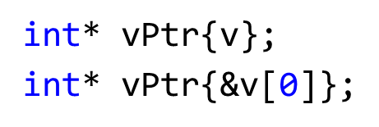
8.8 Pointer Expressions and Pointer Arithmetic (2 of 2)
Assume that int v[5] has been declared and that its first element is at memory location 3000.
Assume that pointer vPtr has been initialized to point to v[0] (i.e., the value of vPtr is 3000).
Figure 8.15 diagrams this situation for a machine with four-byte integers. Variable vPtr can be initialized to point to v with either of the following statements:

Slide 90
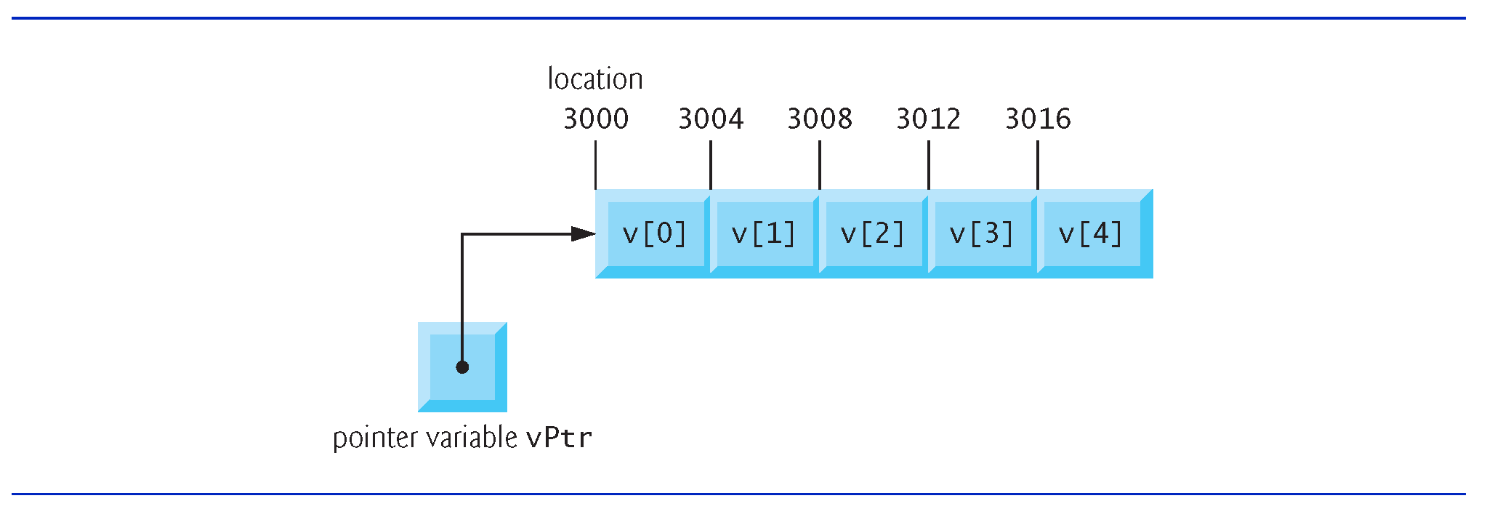
Figure 8.15 Built-In Array v and a Pointer Variable Int* vPtr That Points to v

Slide 91
8.8.1 Adding Integers to and Subtracting Integers from Pointers (1 of 2)
In conventional arithmetic, the addition 3000 + 2 yields the value 3002.
This is normally not the case with pointer arithmetic.
When an integer is added to, or subtracted from, a pointer, the pointer is not simply incremented or decremented by that integer, but by that integer times the size of the memory object to which the pointer refers.
The number of bytes depends on the memory object’s data type.

Slide 92
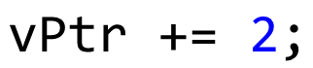
8.8.1 Adding Integers to and Subtracting Integers from Pointers (2 of 2)
•
would produce 3008 (from the calculation 3000 + 2 * 4), assuming that an int is stored in four bytes of memory.
In the built-in array v, vPtr would now point to v[2] (Figure 8.16).
If an integer is stored in eight bytes of memory, then the preceding calculation would result in memory location 3016 (3000 + 2 * 8).

Slide 93
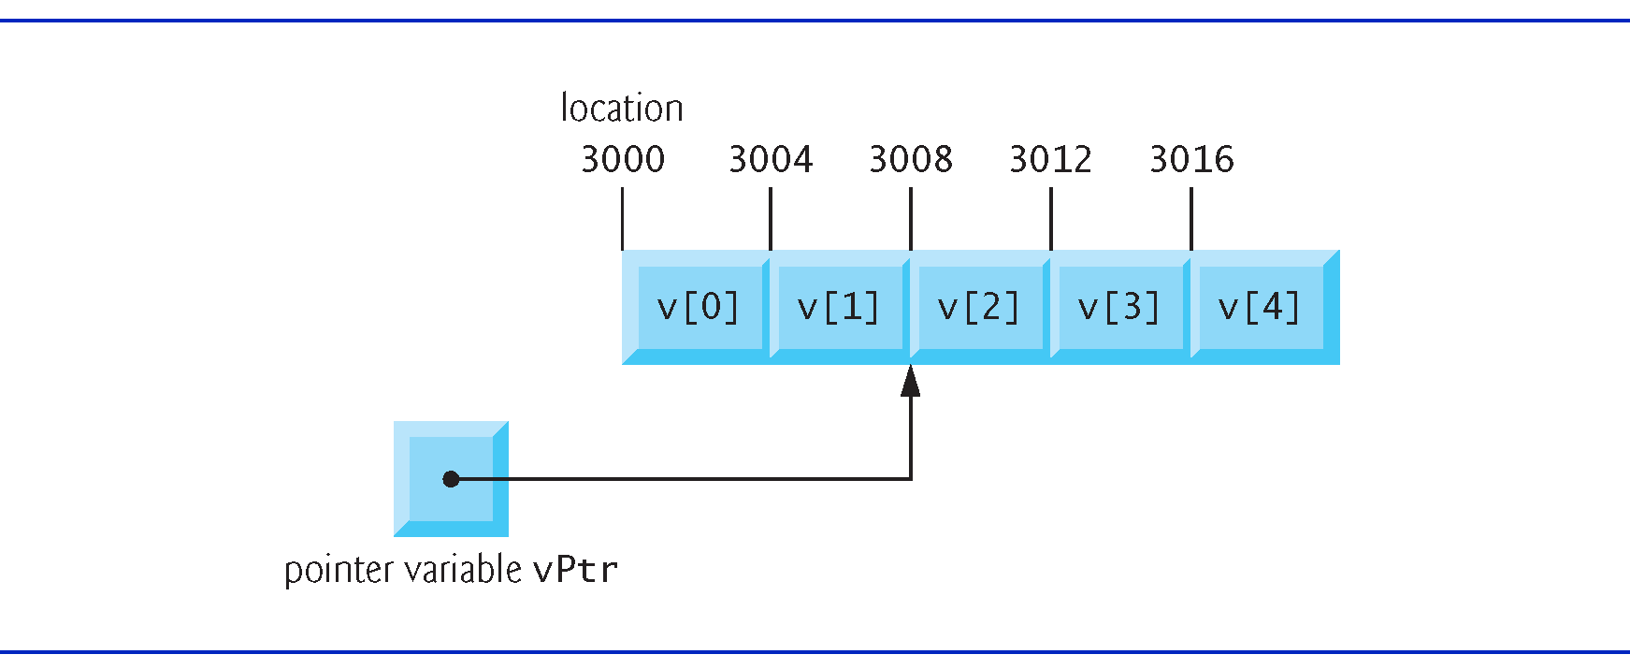
Figure 8.16 Pointer vPtr After Pointer Arithmetic

Slide 94
Error-Prevention Tip 8.5
There’s no bounds checking on pointer arithmetic. You must ensure that every pointer arithmetic operation that adds an integer to or subtracts an integer from a pointer results in a pointer that references an element within the built-in array’s bounds.

Slide 95

8.8.3 Subtracting Pointers
Pointer variables pointing to the same built-in array may be subtracted from one another.
For example, if vPtr contains the address 3000 and v2Ptr contains the address 3008, the statement
would assign to x the number of built-in array elements from vPtr to v2Ptr—in this case, 2.
Pointer arithmetic is meaningful only on a pointer that points to a built-in array.

Slide 96
Common Programming Error 8.4
Subtracting or comparing two pointers that do not refer to elements of the same built-in array is a logic error.

Slide 97
8.8.3 Pointer Assignment
A pointer can be assigned to another pointer if both pointers are of the same type.
Otherwise, a cast operator (normally a reinterpret_cast; discussed in Section 14.7) must be used to convert the value of the pointer on the right of the assignment to the pointer type on the left of the assignment.
Exception to this rule is the pointer to void (i.e., void*).
Any pointer to a fundamental type or class type can be assigned to a pointer of type void* without casting.

Slide 98
Common Programming Error 8.5
Assigning a pointer of one type to a pointer of another (other than void*) without using a cast is a compilation error.

Slide 99
8.8.4 Cannot Dereference a Void*
A void* pointer cannot be dereferenced.
The compiler “knows” that an int* points to four bytes of memory on a machine with four-byte integers—dereferencing an int* creates an lvalue that is an alias for the int’s four bytes in memory.
A void* simply contains a memory address for an unknown data type.
You cannot dereference a void* because the compiler does not know the type of the data to which the pointer refers and thus not the number of bytes.

Slide 100
Common Programming Error 8.6
The allowed operations on void* pointers are: comparing void* pointers with other pointers, casting void* pointers to other pointer types and assigning addresses to void* pointers. All other operations on void* pointers are compilation errors.

Slide 101
8.8.5 Comparing Pointers
Pointers can be compared using equality and relational operators.
Comparisons using relational operators are meaningless unless the pointers point to elements of the same built-in array.
Pointer comparisons compare the addresses stored in the pointers.
A common use of pointer comparison is determining whether a pointer has the value nullptr, 0 or Null (i.e., the pointer does not point to anything).

Slide 102
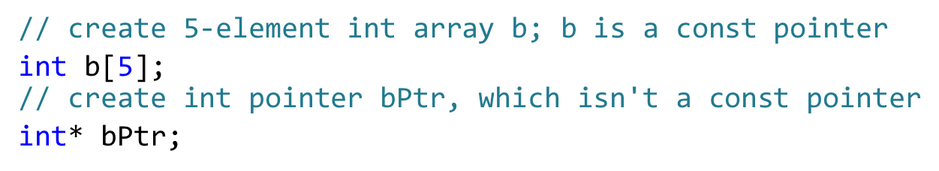
8.9 Relationship between Pointers and Built-In Arrays (1 of 3)
Pointers can be used to do any operation involving array subscripting.
Assume the following declarations:

Slide 103
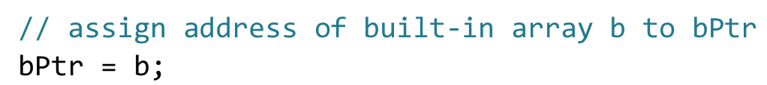
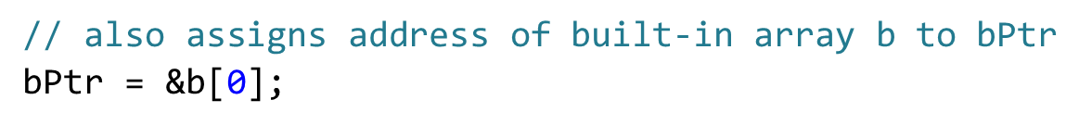
8.9 Relationship between Pointers and Built-In Arrays (2 of 3)
We can set bPtr to the address of the first element in the built-in array b with the statement
This is equivalent to assigning the address of the first element as follows:

Slide 104

8.9.1 Pointer/Offset Notation
Built-in array element b[3] can alternatively be referenced with the pointer expression
The 3 in the preceding expression is the offset to the pointer.
This notation is referred to as pointer/offset notation.
The parentheses are necessary, because the precedence of * is higher than that of +.

Slide 105

8.9 Relationship between Pointers and Built-In Arrays (3 of 3)
Just as the built-in array element can be referenced with a pointer expression, the address
can be written with the pointer expression
bPtr + 3

Slide 106

8.9.2 Pointer/Offset Notation with the Built-In Array’s Name as the Pointer
The built-in array name can be treated as a pointer and used in pointer arithmetic.
For example, the expression
also refers to the element b[3].
In general, all subscripted built-in array expressions can be written with a pointer and an offset.

Slide 107
8.9.3 Pointer/Subscript Notation
Pointers can be subscripted exactly as built-in arrays can.
For example, the expression
refers to b[1]; this expression uses pointer/subscript notation.

Slide 108
Good Programming Practice 8.3
For clarity, use built-in array notation instead of pointer notation when manipulating built-in arrays.

Slide 109
8.9.4 Demonstrating the Relationship between Pointers and Built-In Arrays
Figure 8.17 uses the four notations we just discussed
array subscript notation
pointer/offset notation with the built-in array’s name as a pointer
pointer subscript notation
pointer/offset notation with a pointer
to accomplish the same task, namely displaying the four elements of the built-in array of ints named b.

Slide 110
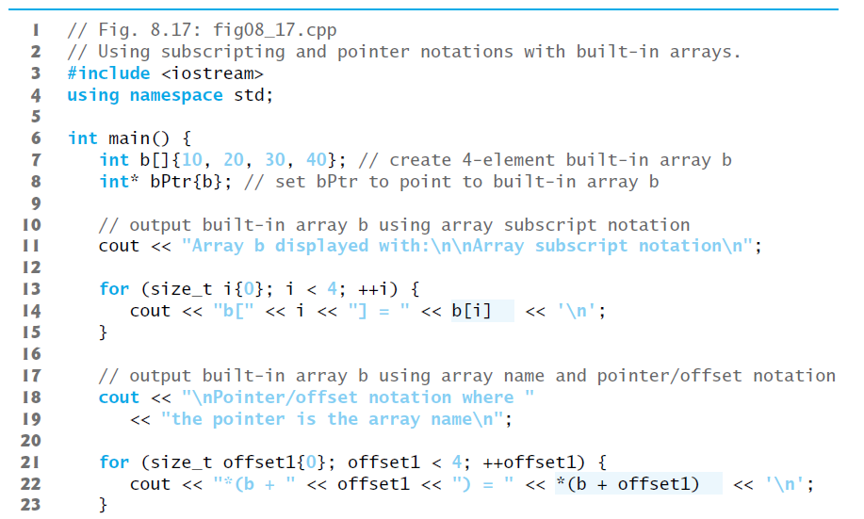
Figure 8.17 Using Subscripting and Pointer Notations with Built-In Arrays (1 of 3)

Slide 111
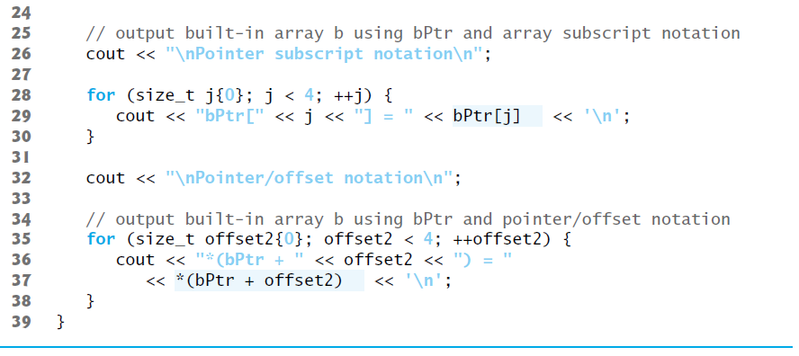
Figure 8.17 Using Subscripting and Pointer Notations with Built-In Arrays (2 of 3)

Slide 112
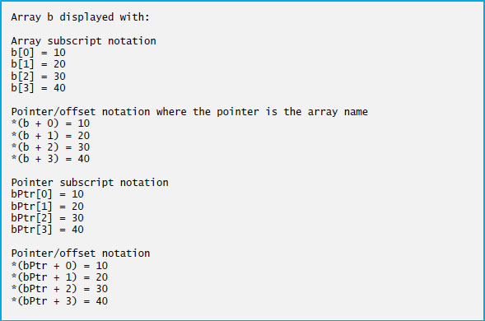
Figure 8.17 Using Subscripting and Pointer Notations with Built-In Arrays (3 of 3)

Slide 113
8.10 Pointer-Based Strings (1 of 11)
This section introduces C - s t y l e, pointer-based strings, which we’ll simply call C strings.
C++’s string class is preferred
it eliminates many of the security problems that can be caused by manipulating C strings.
We cover C strings for a deeper understanding of arrays, and because there are some cases in which C string processing is required.
Also, if you work with legacy C and C++ programs, you’re likely to encounter pointer-based strings.

Slide 114
8.10 Pointer-Based Strings (2 of 11)
Characters and Character Constants
Characters are the fundamental building blocks of C++ source programs.
Character constant
An integer value represented as a character in single quotes.
The value of a character constant is the integer value of the character in the machine’s character set.

Slide 115
8.10 Pointer-Based Strings (3 of 11)
Strings
A string is a series of characters treated as a single unit.
May include letters, digits and various special characters such as +, −, *, /and $.
String literals, or string constants, in C++ are written in double quotation marks

Slide 116
8.10 Pointer-Based Strings (4 of 11)
Pointer-Based Strings
A pointer-based string is a built-in array of characters ending with a null character ('\0').
A string is accessed via a pointer to its first character.
The sizeof a string literal is the length of the string including the terminating null character.

Slide 117
8.10 Pointer-Based Strings (5 of 11)
String Literals as Initializers
A string literal may be used as an initializer in the declaration of either a built-in array of chars or a variable of type const char*.
String literals exist for the duration of the program and may be shared if the same string literal is referenced from multiple locations in a program.

Slide 118
8.10 Pointer-Based Strings (6 of 11)
Character Constants as Initializers
When declaring a built-in array of chars to contain a string, the built-in array must be large enough to store the string and its terminating null character.

Slide 119
Common Programming Error 8.7
Not allocating sufficient space in a built-in array of chars to store the null character that terminates a string is a logic error.

Slide 120
Common Programming Error 8.8
Creating or using a C string that does not contain a terminating null character can lead to logic errors.

Slide 121
Error-Prevention Tip 8.6
When storing a string of characters in a built-in array of chars, be sure that the built-in array is large enough to hold the largest string that will be stored. C++ allows strings of any length. If a string is longer than the built-in array of chars in which it’s to be stored, characters beyond the end of the built-in array will overwrite data in memory following the built-in array, leading to logic errors and potential security breaches.

Slide 122
8.10 Pointer-Based Strings (7 of 11)
Accessing Characters in a C String
Because a C string is a built-in array of characters, we can access individual characters in a string directly with array subscript notation.

Slide 123
8.10 Pointer-Based Strings (8 of 11)
Reading Strings into Built-In Arrays of char with c in
A string can be read into a built-in array of chars using stream extraction with c in.
The setw stream manipulator can be used to ensure that the string read into word does not exceed the size of the built-in array.
Applies only to the next value being input.

Slide 124
8.10 Pointer-Based Strings (9 of 11)
Reading Lines of Text into Built-In Arrays of char with c in.getline
In some cases, it’s desirable to input an entire line of text into a built-in array of chars.
For this purpose, the cin object provides the member function getline, which takes three arguments—a built-in array of chars in which the line of text will be stored, a length and a delimiter character.
The function stops reading characters when the delimiter character '\n' is encountered, when the end-of-file indicator is entered or when the number of characters read so far is one less than the length specified in the second argument.
The third argument to c in.getline has '\n' as a default value.

Slide 125
8.10 Pointer-Based Strings (10 of 11)
Displaying C Strings
A built-in array of chars representing a null-terminated string can be output with c out and <<.
The characters are output until a terminating null character is encountered; the null character is not displayed.
c in and c out assume that built-in arrays of chars should be processed as strings terminated by null characters; c in and c out do not provide similar input and output processing capabilities for other built-in array types.

Slide 126
8.10 Pointer-Based Strings (11 of 11)
Displaying C Strings
A built-in array of chars representing a null-terminated string can be output with c out and <<.
The characters are output until a terminating null character is encountered; the null character is not displayed.
c in and c out assume that built-in arrays of chars should be processed as strings terminated by null characters; c in and c out do not provide similar input and output processing capabilities for other built-in array types.

Slide 127
8.11 Note about Smart Pointers
Later in the book, we introduce dynamic memory management with pointers, which allows you at execution time to create and destroy objects as needed.
Improperly managing this process is a source of subtle errors.
We’ll discuss “smart pointers,” which help you avoid dynamic memory management errors by providing additional functionality beyond that of built-in pointers.

Slide 128

Copyright

